Slide 1
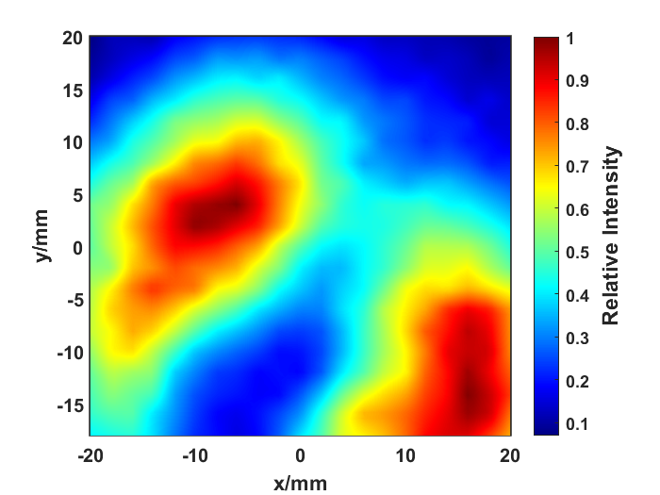
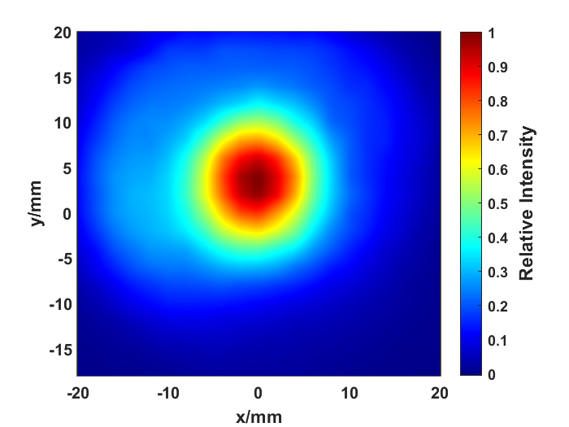
(a)
(b)

Slide 2

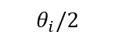
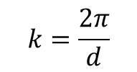

Incident wave
Scattering wave
$$θ_{i}/2$$
$$k=\frac{2π}{d}$$
d
Plasma turbulence
$$nλ=2dsinθ$$
$$k=2k_{i}sinθ$$

Slide 3
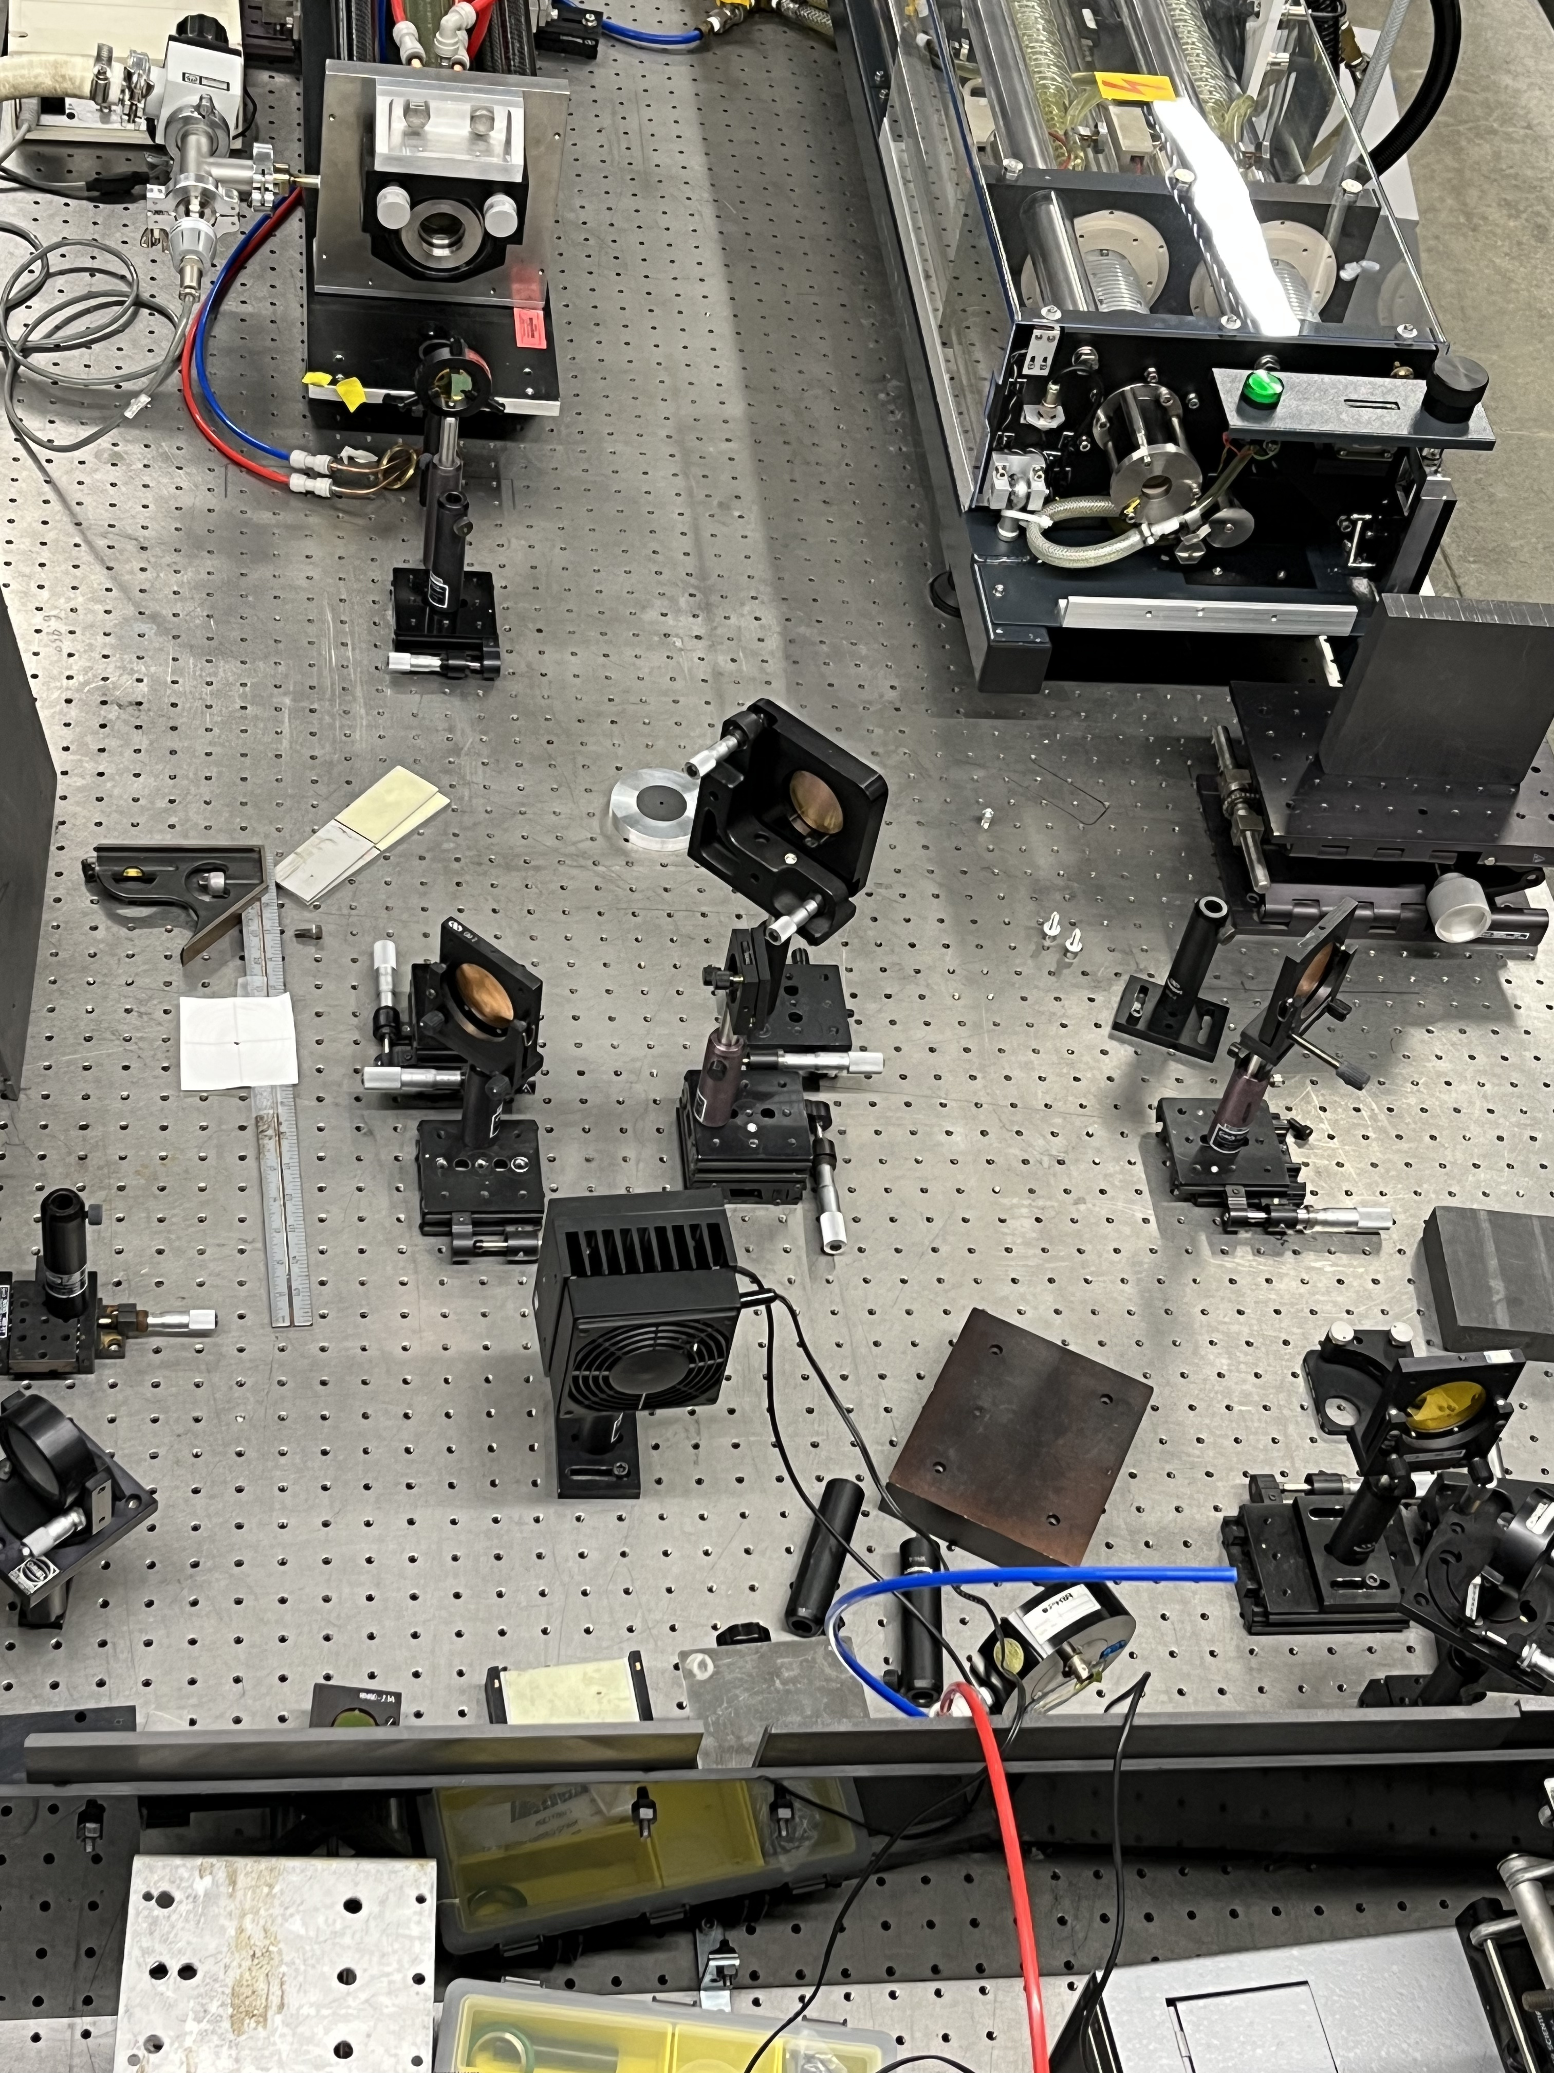
CO₂ laser system
FIR input window
CO₂ laser output window
Beam Splitter
mirror
Focus lens
mirror
Power Monitor

